Slide 1
PIP4004 - INTERNSHIP Review-3 Presentation TITLE OF THE PROJECT / WORK ASSIGNED / DOMAIN
Student Details
Name | PRINCE GUPTA
Roll No | 20211CCS0096
Section | 8CCS2
Batch No. | -
Under the Supervision of,
Dr. Sharmasth Vali Y
Professor
School of Computer Science and Engineering
Presidency University
Name of the Program: Computer Science Engineering
Name of the HoD: Dr. ANAND RAJ
Name of the Program Project Coordinator: Dr Sharmasth Vali Y
Name of the School Internship/Project Coordinators: Mr. Md Ziaur Rahman /
Dr. Sampath A K / Dr. Abdul Khadar A

Slide 2
Content
About Company or Organization
Working domain or the technology
About your team and reporting Manager
Challenges Faced in Internship
Objectives of the work
Proposed System
Problem Statement
System Requirements
Advantages of Proposed System/Work
Internship Roadmap
Github Link

Slide 3
About Company
Telaverge provides Telecom services like 2G, 3G, 4G and 5G.
They have inhouse softwares facilitating test automation and infrastructure deployment processes.
Telaverge platform supports the optimization of telco operations,
addressing new challenges posed by cloudification,
microservices deployments, and open RAN technologies.
Become future ready, from legacy to 4G, 5G 6G and beyond!

Slide 4
Working domain
The internship focuses on Diameter product integration with Regal in the Telecom industry.
The work involves writing test automations, testing and developing diameter protocol standards.
Diameter protocol involves several interfaces which facilitates AAA(Authorization, authentication and accounting). Currently Working on Multi-Interface Project

Slide 5
About your team and reporting Manager
Reporting Manager: Jakati Vikram (Director of Engineering)
Team: Jeslin Abi(Team lead), Venkataraman Swamynathan(Lead Engineer), Poornima A Totadi (SE R&D).

Slide 6
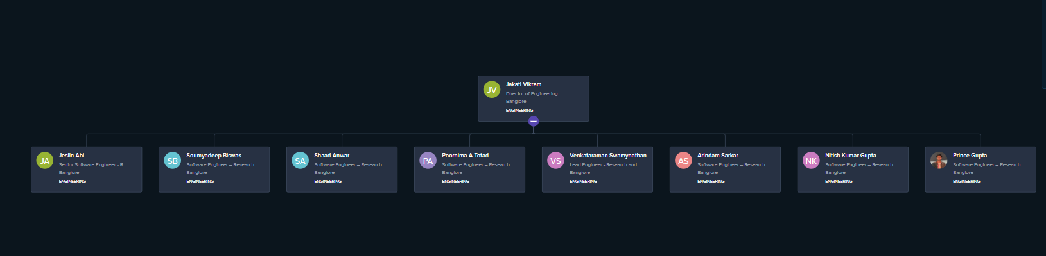
Tree Structure of Team

Slide 7
Challenges Faced in Internship
Regal as a product as lot of changes frequently which makes updating the Regal to the newer version a time-consuming process.
For every new release, lot of documentation must be read to develop new feature.
In my Team I am the only one who is working with Regal so If I encounter an Error, I should communicate with other Teams Ongoing issue : Facing challenges with SCTP protocol.

Slide 8
Objectives of the work
Developing code for automation for testing environment using inhouse tools.
Developing MarketPlace Modules for Sales purposes
Create structured reports that aid in decision-making.

Slide 9
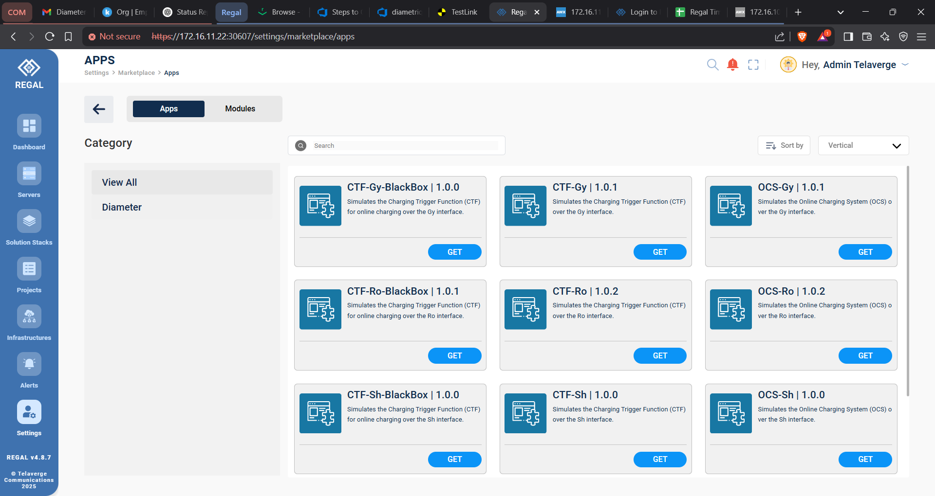
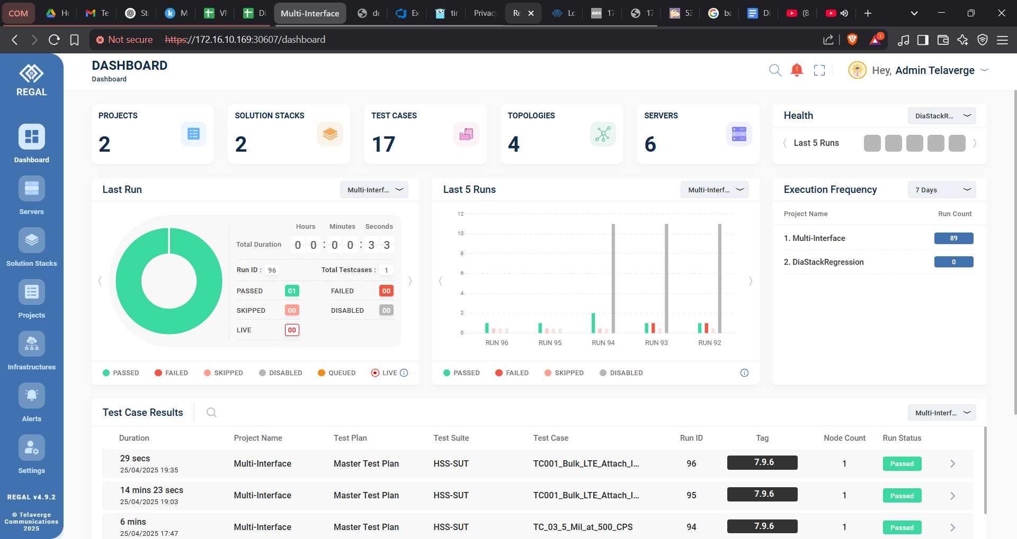

Slide 10
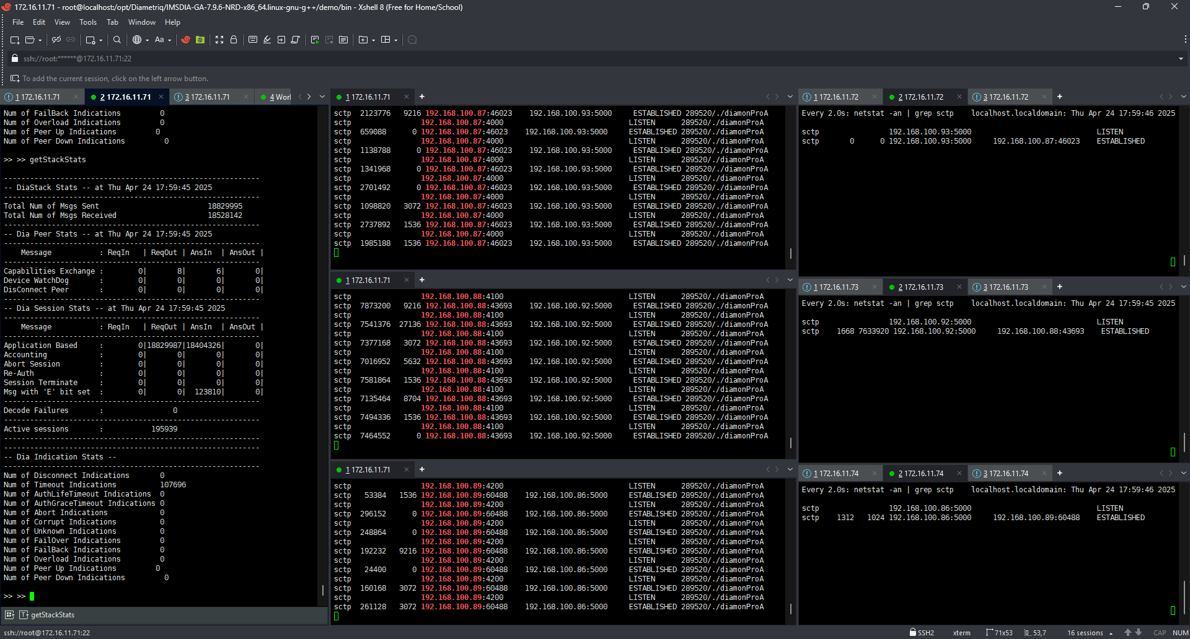

Slide 11
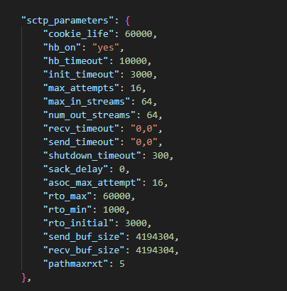

Slide 12
Proposed System / Work
Worked on Developing and integration of Multi-Interface DiamonPro with Regal.
Currently Working on Client Project – Multi-Interface DaimonPro client between the nodes HSS,MME, CSCF, AP with interface S6a, Cx, Sh.

Slide 13
Problem Statement
Write Code to Automate Testing for DiamonPro Binary Stack, DiaStack Binary and upload Working Suts to Marketplace.
Implement Intergartions and Validation Logic for Testcase of Multi-Interface.

Slide 14
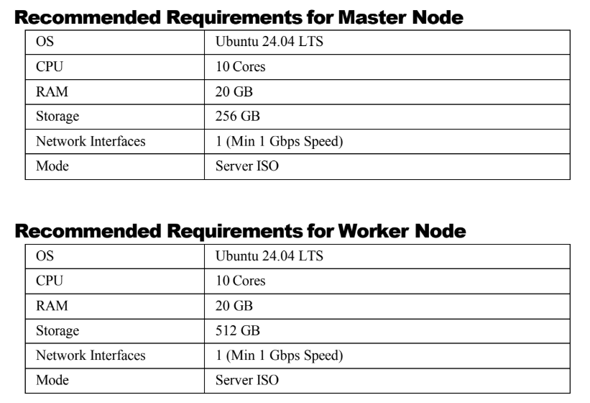
System Requirements

Slide 15
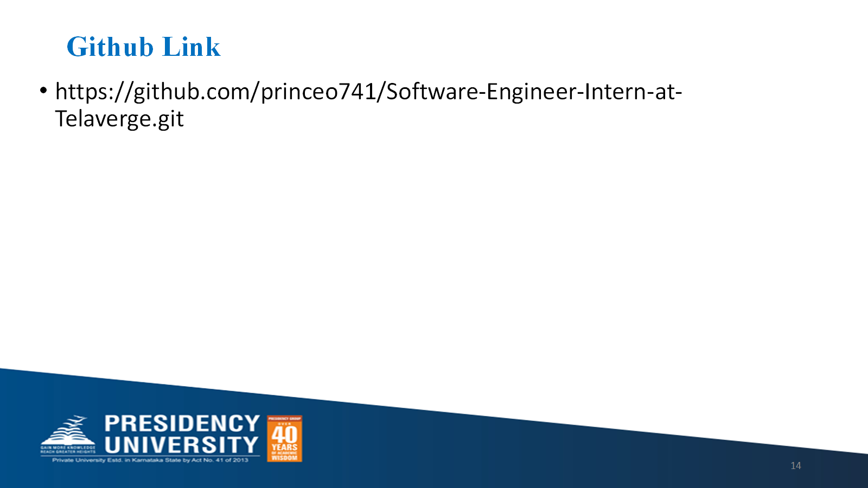
Internship Road Map
Note: Write in the below table what u will be achieving in each review
Review 0
Understand Team and Tools
Review 1
Working with The Interface and contributing to the Team
Review 2
Develop Automation Code for Diameter Stack
Review 3
Start working on Client Projects

Slide 16
Q&A

Slide 17
Thank you !!

